Slide 1
PRODUCT SALES ANALYSIS
SUBMITTED BY
Thiyaneshwaran l
PSN ENGINEERING COLLEGE

Slide 2
INTRODUCTION
To analyze sales data and extract insights about top selling product ,peaks periods, and customer preference. the objective is to help business improve inventory management and marketing strategies by understanding sales trend and customer behavior . This project includes defining analysis objectives , collecting sales data , designing revelant visualization and deriving actionable insights

Slide 3
DATASET OVERVIEW
Dataset contains
Order Id
Product
Quality Ordered
Price Each
Ordered Date
Purchase Address
Month
Sales
City
Hour

Slide 4
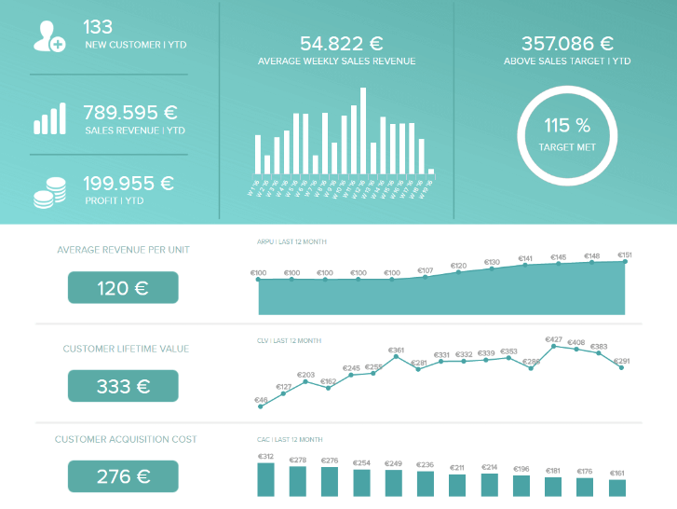
SALES TRENDS
To identify sales technique which product goes to high purchase at this season

Slide 5
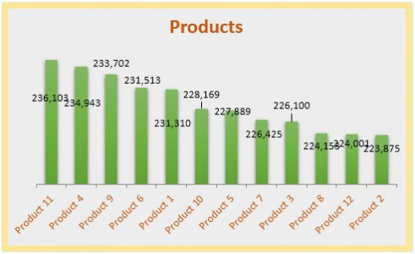
PRODUCT PERFORMANCE
To improve product performance which product most selling

Slide 6
CONCLUSION
This presentation is refers to improve the product selling and suggest to the user to purchase a product
Its recommend to good product from the previous purchasing history using dataset
Sales promotion methods or scheme are used at mainly the level of declares, consumers and salesman.

